Slide 1
Lecture 34
Dec. 6th , 2019
Exam 3 returned Friday if possible
GFP paper returned Monday
Great job in lab!
Exam 4 next Friday—Dec. 13th.

Slide 2
Where were we?
DNA replication—Molecular details.
  DNA polymerases—what do they do? What do they require?
  Origins of replication/ARS sequences

Slide 3
The DNA templates will be antiparallel DNA strands…
If DNA synthesis begins at one position, and if both strands are to be copied, we must consider some potential problems…
Either DNA synthesis must proceed in 5’--3’ direction on one strand and 3’--5’ direction on the other strand
OR
DNA synthesis must proceed in opposite directions from a starting point.

Slide 4
All DNA polymerases sythesize DNA 5’-3’
**Therefore DNA synthesis likely proceeds in opposite directions on the 2 template strands.

Slide 5
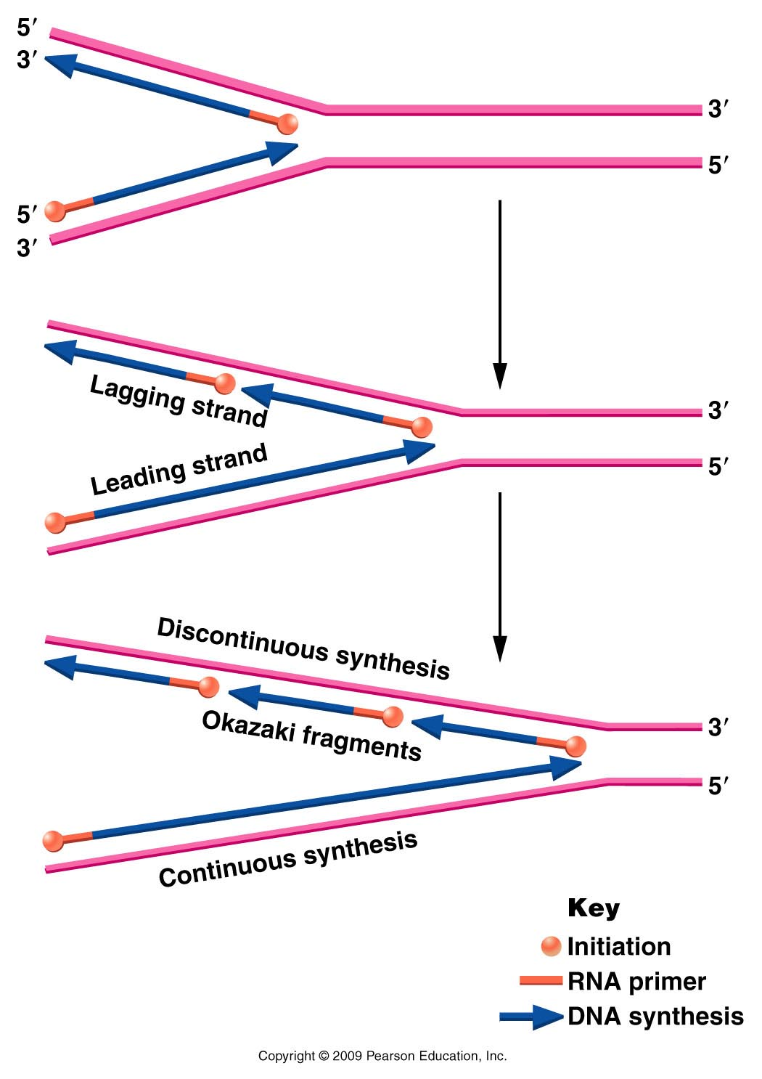
Figure 11.11
Notes:
Figure 11-11 Opposite polarity of DNA synthesis along the two strands, necessary because the two strands of DNA run antiparallel to one another and DNA polymerase III synthesizes only in one direction ( to ). On the lagging strand, synthesis must be discontinuous, resulting in the production of Okazaki fragments. On the leading strand, synthesis is continuous. RNA primers are used to initiate synthesis on both strands.

Slide 6
However, the best way to conserve energy and to stay organized in replication is to proceed from one start point and move in one overall direction.
(But replication must proceed in opposite directions!!)

Slide 7
Solution…
Continuous and discontinuous replication…
One strand (leading strand template) allows for continuous DNA synthesis in one direction.
Other strand (lagging strand template) requires DNA synthesis in the opposite direction, but it can occur in short, discontinuous stretches.

Slide 8
Figure 11.11
Notes:
Figure 11-11 Opposite polarity of DNA synthesis along the two strands, necessary because the two strands of DNA run antiparallel to one another and DNA polymerase III synthesizes only in one direction ( to ). On the lagging strand, synthesis must be discontinuous, resulting in the production of Okazaki fragments. On the leading strand, synthesis is continuous. RNA primers are used to initiate synthesis on both strands.

Slide 9
Short fragments of DNA made from the lagging strand, called Okasaki fragments.
Eventually primers are removed and Okasaki fragments are linked into a continuous strand of DNA. (Role of Rnase, DNA pol I , and DNA ligase in prokaryotes like E. coli) (Details coming!)
This extra work takes time so the synthesis lags behind the continuous synthesis.

Slide 10
View this animation
(also found on website)
http://www.wiley.com/college/pratt/0471393878/student/animations/dna_replication/index.html
It is an excellent review!!!!!

Slide 11
Let’s look closer at one replication fork. Recall both strands are being copied simultaneously and the polymerase enzymes are moving in one overall direction.
Current model for how this might work.

Slide 12
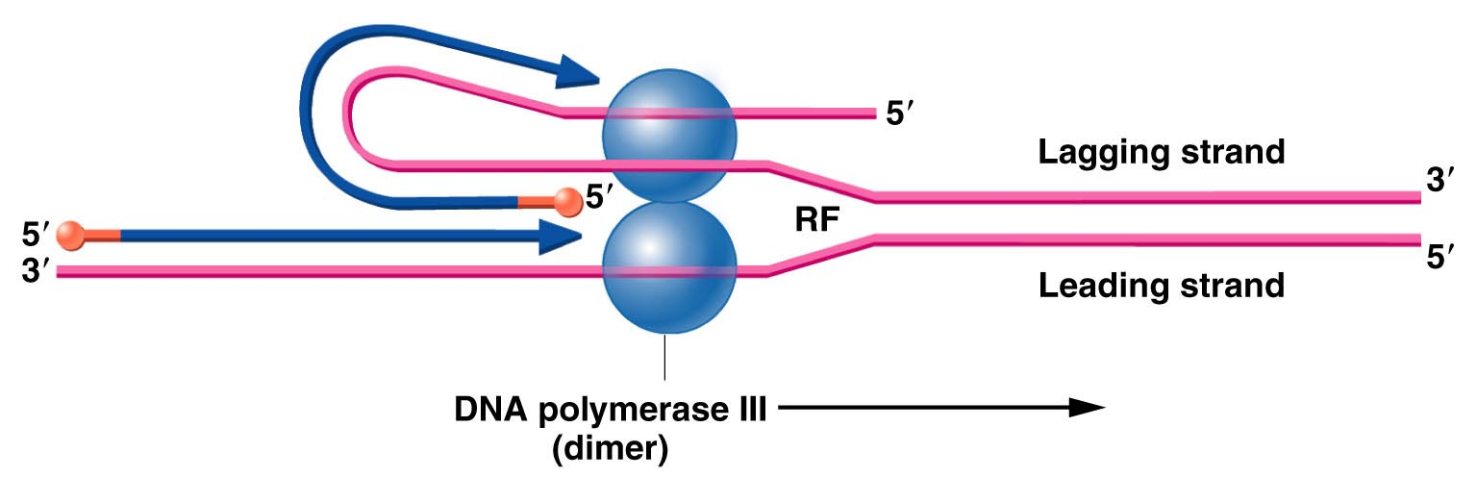
Figure 11.12
Notes:
Figure 11-12 Illustration of how concurrent DNA synthesis may be achieved on both the leading and lagging strands at a single replication fork. The lagging template strand is “looped” in order to invert the physical direction of synthesis, but not the biochemical direction. The enzyme functions as a dimer, with each core enzyme achieving synthesis on one or the other strand.

Slide 13
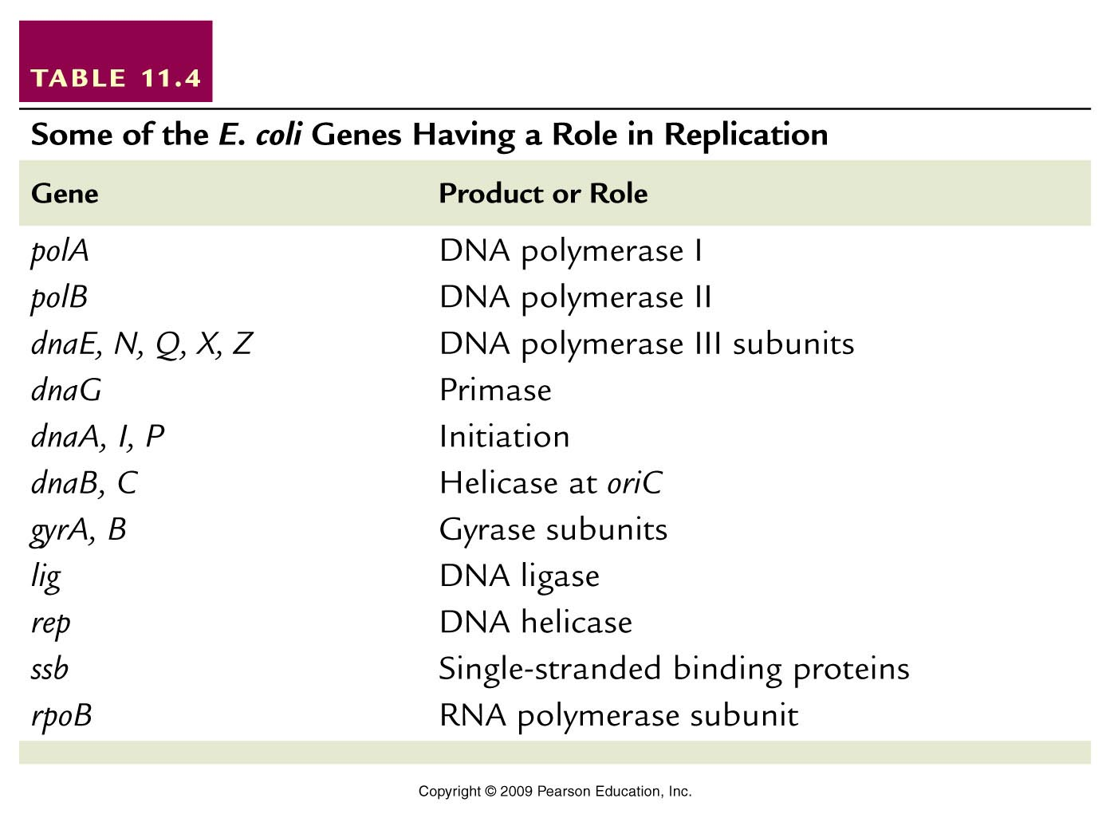
DNA polymerase must have many helper proteins…
Helper proteins
Table 11.4
Notes:
Table 11-4 Some of the E. coli Genes Having a Role in Replication

Slide 14
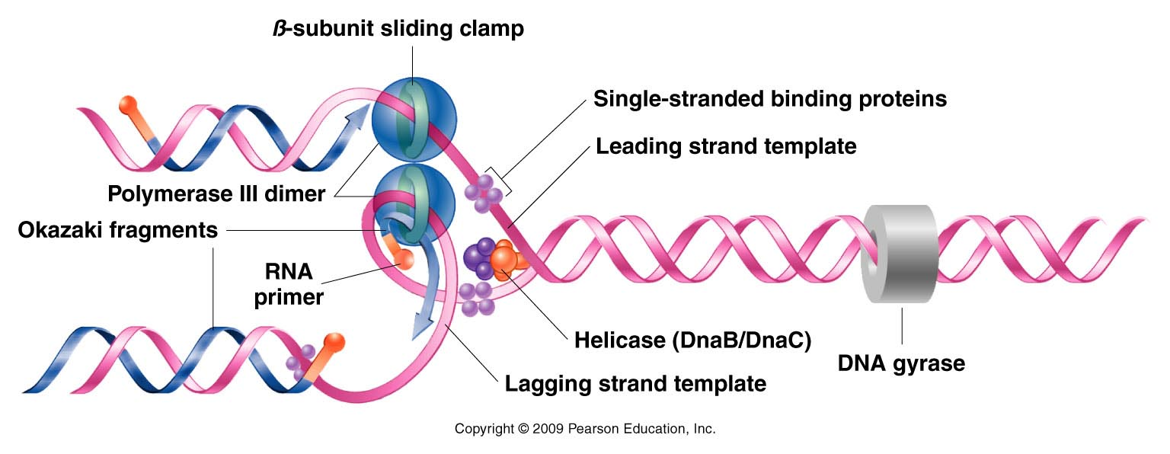
A more detailed look showing the relative positions of the helper proteins at a replication fork. Study and re-sketch!
Figure 11.13
Notes:
Figure 11-13 Summary of DNA synthesis at a single replication fork. Various enzymes and proteins essential to the process are shown.

Slide 15
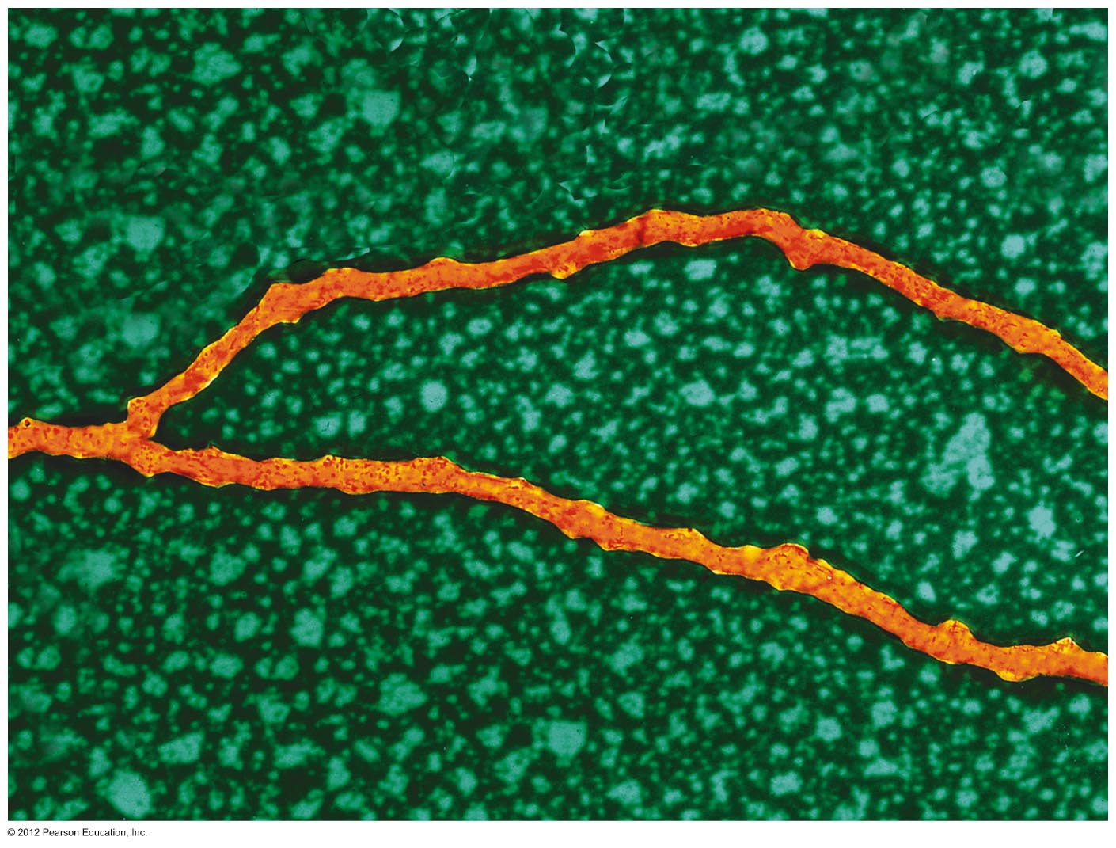
An actual replication fork
Notes:
Chapter 11 Opener

Slide 16
Bacteria like E. coli have a single origin of replication which creates one replication bubble which forms two replication forks.
This creates conditions in which leading and lagging strands are opposite in the 2 different replication forks. It saves time for replication!

Slide 17
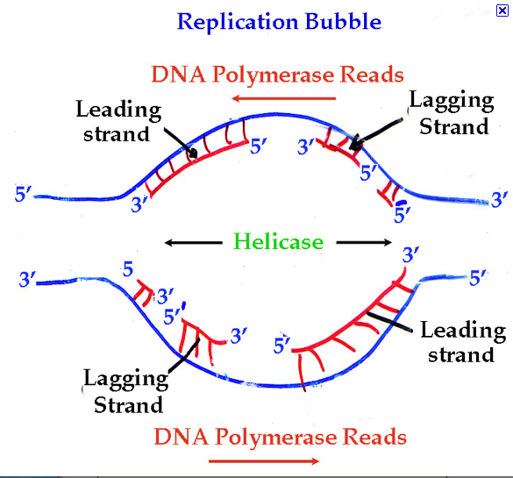
Study this!

Slide 18
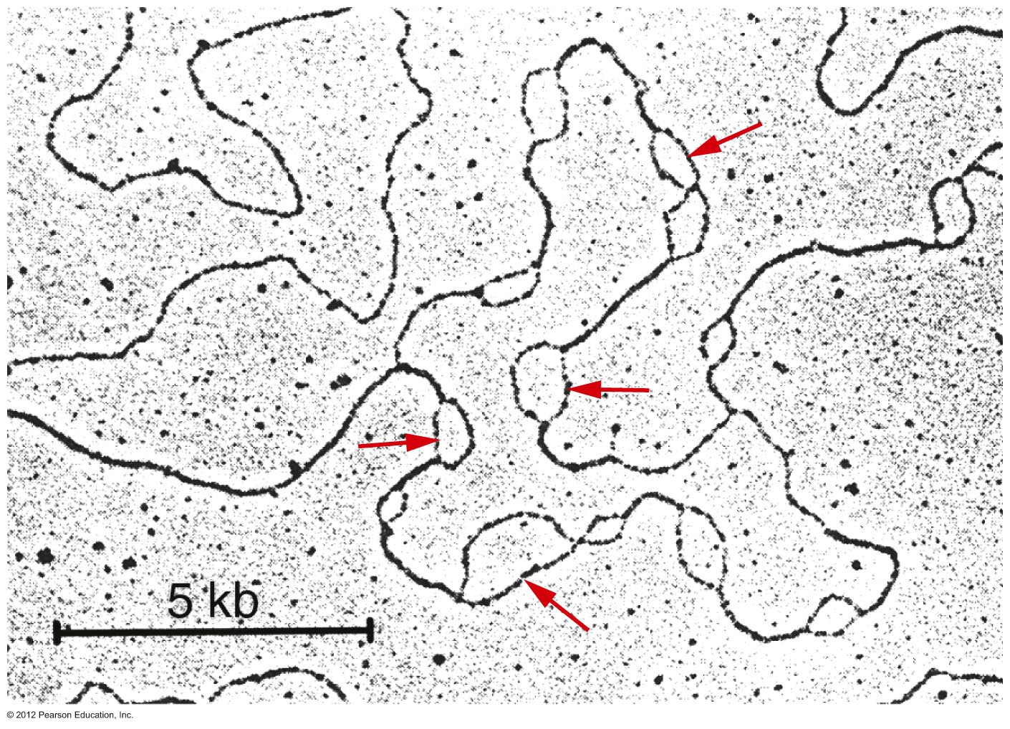
Eukaryotic cells have linear chromosomes which have multiple ARS sequences. Many replication bubbles form. Each bubble makes 2 replication forks.
Notes:
Figure 11.14

Slide 19
Discontinuous replication…more detail….
Obviously the lagging strand cannot be left as small unlinked fragments of DNA (with bits of RNA left from the primers).
  In E. coli the primary role of DNA polymerase I (or Rnase H in eukaryotes) is the removal of RNA primers and simultaneous replacement with DNA.

Slide 20
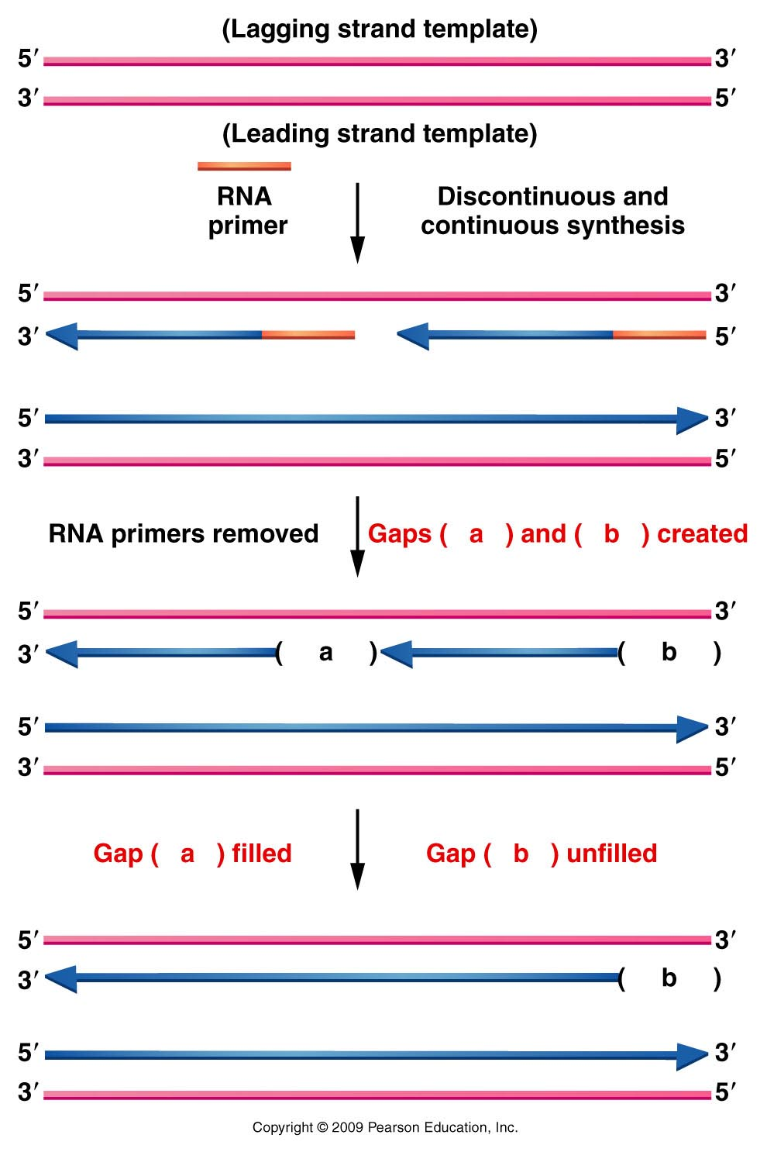
Figure 11.16
Notes:
Figure 11-16 Diagram illustrating the difficulty encountered during the replication of the ends of linear chromosomes. A gap (- -b- -) is left following synthesis on the lagging strand.

Slide 21
DNA polymerase I actually has dual activity. It can digest RNA (so it is an Rnase) AND it can make DNA (so it is also a DNA polymerase).
DNA polymerases are complexes of proteins with different activities---

Slide 22
DNA polymerase I extends the adjacent Okasaki fragment till bumps into the next one. However, it I cannot link the individual Okasaki fragments.
Role of yet another helper protein called DNA ligase.
Lagging strand template
Okasaki fragment 1
Okasaki fragment 2
DNA ligase—makes the phosphodiester bond

Slide 23
One final detail…
  All DNA polymerases can occasionally make mistakes when reading the DNA template.
  3’AGCCTCGAACGGTAATT….(template)
  5’TCGGAGCTTA
  DNA polymerase III makes a mistake, adding A instead of G
DNA polymerase III

Slide 24
DNA polymerase III has built-in proofreading and error correction activity.
  3’AGCCTCGAACGGTAATT…..(template)
  5’TCGGAGCTTG
  DNA polymerase III corrects its mistake, replacing A with G before moving on to next nucleotide
DNA polymerase III

Slide 25
What about linear chromosomes?...Most of what we have discussed describes E. coli
A problem arises with primed replication at DNA ends.
Let’s revisit a slide

Slide 26
Figure 11.16
Notes:
Figure 11-16 Diagram illustrating the difficulty encountered during the replication of the ends of linear chromosomes. A gap (- -b- -) is left following synthesis on the lagging strand.

Slide 27
After each round of replication, the lagging strand has an unfilled gap, where primers are removed, but if no adjacent Okasaki fragment exists, the gap cannot be filled.
Since this strand serves as template in the next round of replication there is potential for continued shortening of each linear chromosome.

Slide 28
The solution?
Telomeres!
Telomeres are sections of DNA at the ends of linear chromosomes that you don’t inherit from your parents.
Telomeres are created by an enzyme called telomerase (clever name huh?)

Slide 29
Telomerase is an interesting enzyme which uses its own built in template to copy short repeats which are added to the ends of the inherited DNA. Telomeres are just repeats of this DNA sequence.
The template is actually RNA!

Slide 30
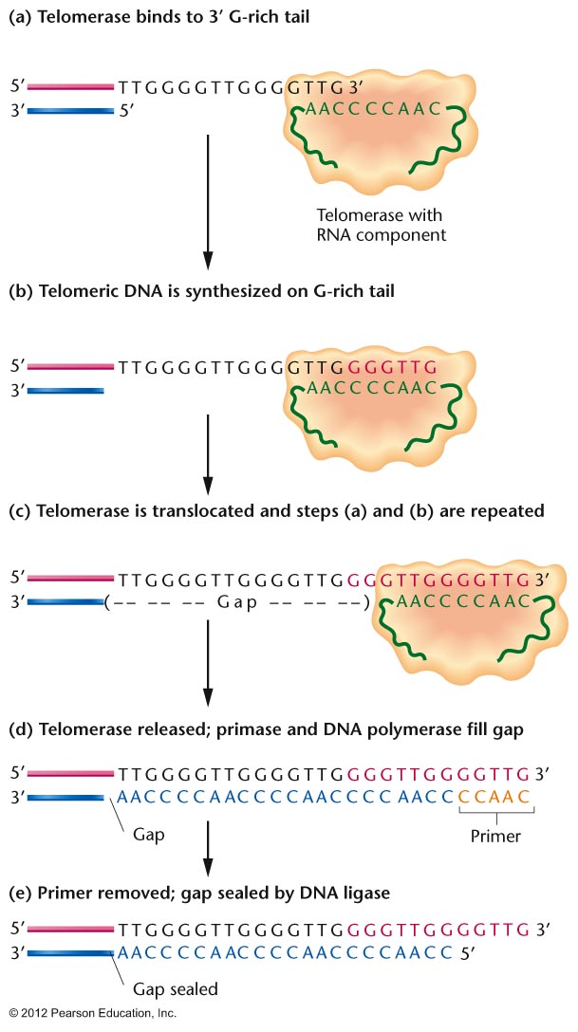
Notes:
Figure 11.17

Slide 31
Moving on from DNA and DNA replication…
Gene expression—decoding the DNA
Jumping to Chapter 13, which considers DNA as the genetic material, the code for development and activities of living things.
Historically, we assumed the proteins encoded by DNA were the essential control molecules of cells.

Slide 32
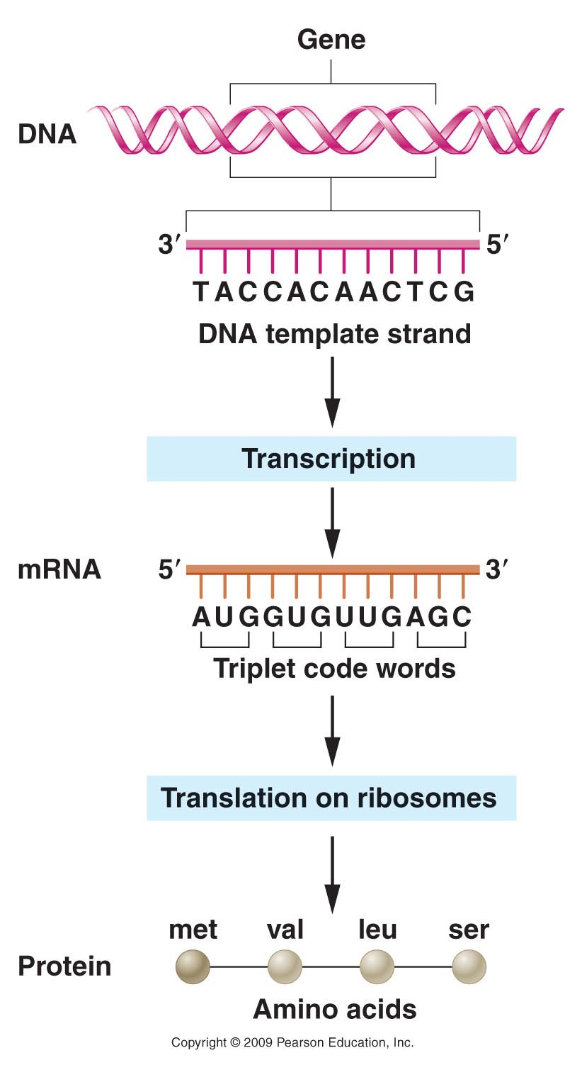
trait/phenotype
Figure 14.1
Notes:
32
Figure 14-1 Flow of genetic information encoded in DNA to messenger RNA to protein.

Slide 33
Tall and short plants are assumed to be the result of different versions/amounts of the same protein.
trait/phenotype
Figure 14.1
Notes:
33
Figure 14-1 Flow of genetic information encoded in DNA to messenger RNA to protein.

Slide 34
Prokaryotes’ chromosomes are nearly all protein coding sequence for the proteins they make. Little inter-gene sequence and proteins are encoded continuously (with no introns).
Many eukaryotic organisms, including humans have much more DNA than is needed for the proteins they make. (Lots of intergene sequence and genes are interupted with introns).
  E.g. humans make about 25,000 proteins. The protein encoding genes include only about 2% of the DNA in our 23 pairs of chromosomes.

Slide 35
A genetic puzzle…
Why do eukaryotic organisms contain so much non-protein coding DNA?

Slide 36
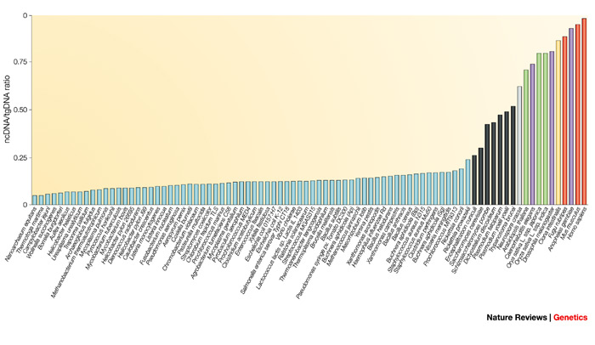
humans
>98% non-coding
Amount of non-protein-coding DNA
eukaryotes
Bacteria

Slide 37
One reason? RNA is probably more important than anyone predicted!!
Shift to studying RNA itself as an (equally?) important regulatory molecule.
  Much of the “non-coding” DNA encodes RNA which functions as RNA, without being translated to protein.
    e.g. ---a class of RNAs called microRNAs.

Slide 38
Chapter 13…
We will still focus on the “original” central dogma of genetics.
  -The classical view
  of the flow of genetic
  information from DNA
  to protein.

Slide 39
Gene expression begins with transcription of DNA into RNA.
Mechanism has many similarities to replication.
  A polymerase enzyme copies a DNA template (single strand)
  New strand of RNA is complementary to the DNA sequence.

Slide 40
DNA (portion of a gene)
3’----G-C-A-A-T-C-T-A----5’…
5’----C-G-T-T-A-G-A-T---3’…

Slide 41
coding strand
DNA
3’----G-C-A-A-T-C-T-A----5’…
5’----C-G-T-T-A-G-A-T---3’…

Slide 42
coding strand
Non-coding strand
DNA
3’----G-C-A-A-T-C-T-A----5’…
5’----C-G-U-U-A-G-A-U---3’…
(complementary RNA)
5’----C-G-T-T-A-G-A-T---3’…

Slide 43
Several key differences
Only specific regions of the DNA are transcribed into RNA (Genes)
  --90+% of bacteria genome is genes
  --<2% of human genome is genes (as traditionally defined)
  2. Within genes only one of the 2 strands is transcribed (coding strand)

Slide 44
Newly made RNA dissociates from the DNA template. (not like semi-conservative replication)
Enzyme is RNA polymerase.

Slide 45
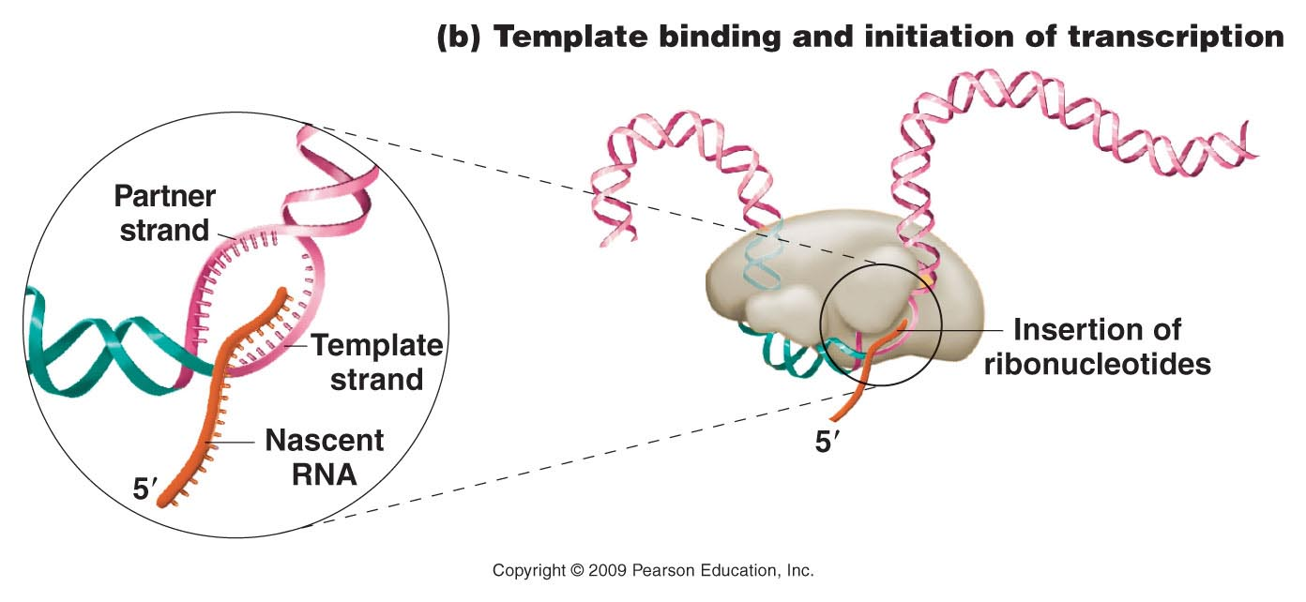
RNA polymerase

